Slide 1
Mathematical Induction
The new elements in this lecture are a few variants of induction:
Strong induction
Well Ordering Principle

Slide 2
Strong Induction
Strong induction
Prove P(0).
Then prove P(n+1) assuming all of
P(0), P(1), …, P(n) (instead of just P(n)).
equivalent
Ordinary induction
0 → 1, 1 → 2, 2 → 3, …, n-1 → n.
So by the time we got to n+1, already know all of
P(0), P(1), …, P(n)
The point is: assuming P(0), P(1), up to P(n), it is often easier to prove P(n+1).

Slide 3
Divisibility by a Prime
Theorem. Any integer n > 1 is divisible by a prime number.
Let n be an integer.
If n is a prime number, then we are done.
Otherwise, n = ab, both are smaller than n.
If a or b is a prime number, then we are done.
Otherwise, a = cd, both are smaller than a.
If c or d is a prime number, then we are done.
Otherwise, repeat this argument, since the numbers are
getting smaller and smaller, this will eventually stop and
we have found a prime factor of n.
Remember this slide?
Now we can prove it
by strong induction
very easily. In fact
we can prove a
stronger theorem
very easily.
Idea of induction.

Slide 4
Prime Products
Claim: Every integer > 1 is a product of primes.
Proof: (by strong induction)
Base case is easy.
Suppose the claim is true for all 2 <= i < n.
Consider an integer n.
If n is prime, then we are done.
So n = k·m for integers k, m where n > k,m >1.
Since k,m smaller than n,
By the induction hypothesis, both k and m are product of primes
k = p₁⋅ p₂⋅ ⋅ ⋅ p₉₄
m = q₁⋅ q₂⋅ ⋅ ⋅ q₂₁₄

Slide 5
Prime Products
Claim: Every integer > 1 is a product of primes.
…So
n = k⋅ m = p₁⋅ p₂⋅ ⋅ ⋅ p₉₄⋅ q₁⋅ q₂⋅ ⋅ ⋅ q₂₁₄
is a prime product.
∴ This completes the proof of the induction step.

Slide 6
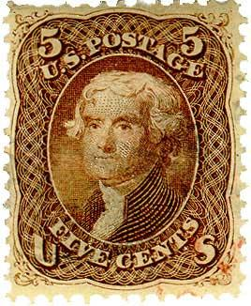

Postage by Strong Induction
Available stamps:
5¢
3¢
What amount can you form?
Theorem: Can form any amount ≥ 8¢
Prove by strong induction on n.
P(n) ::= can form (n +8)¢.

Slide 7
Postage by Strong Induction
Base case (n = 0):
(0 +8)¢:
Inductive Step: assume (m +8)¢ for 0 m  n,
then prove ((n +1) + 8)¢
cases:
n +1= 1, 9¢:
n +1= 2, 10¢:

Slide 8
Postage by Strong Induction
case n +1 ≥ 3: let m =n − 2.
now n ≥ m ≥ 0, so by induction hypothesis have:
+
= (n +1)+8
3
(n −2)+8
We’re done!
In fact, use at most two 5-cent stamps!

Slide 9
Postage by Strong Induction
Given an unlimited supply of 5 cent and 7 cent stamps,
what postages are possible?
Theorem: For all n >= 24,
it is possible to produce n cents of postage from 5¢ and 7¢ stamps.

Slide 10
This Lecture
Strong induction
Well Ordering Principle
Invariant Method

Slide 11
Well Ordering Principle
Every nonempty set ofnonnegative integers
has a least element.
Axiom
This is an axiom equivalent to the principle of mathematical induction.
Note that some similar looking statements are not true:
Every nonempty set of nonnegative rationals
has a least element.
NO!
Every nonempty set of nonnegative integers
has a least element.
NO!

Slide 12
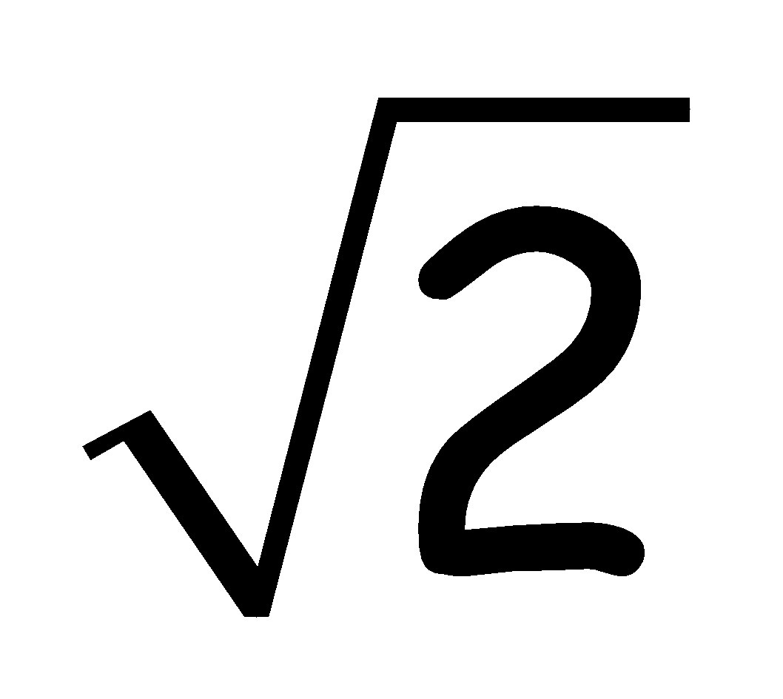
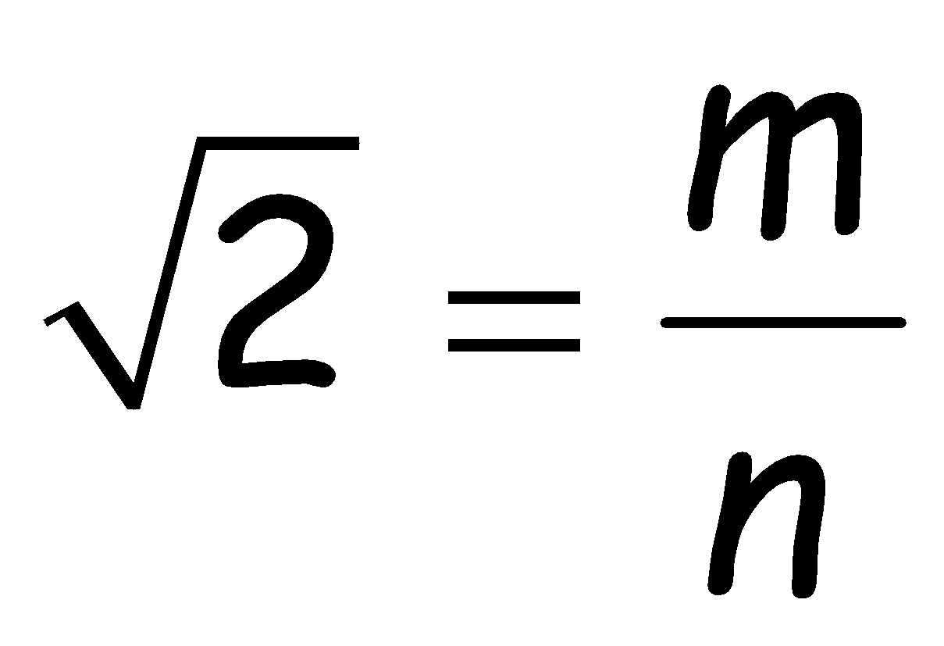
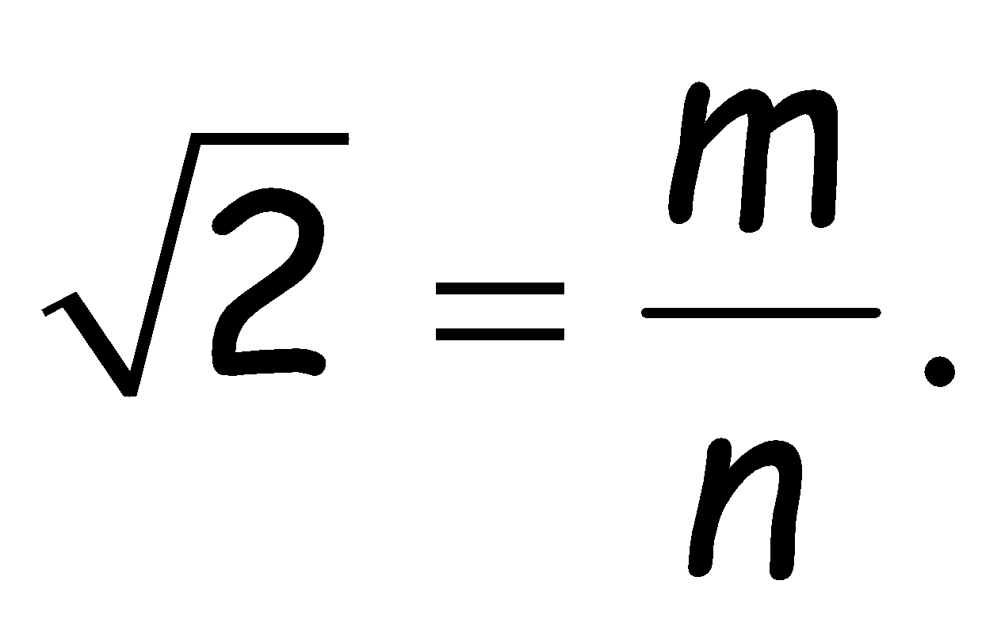
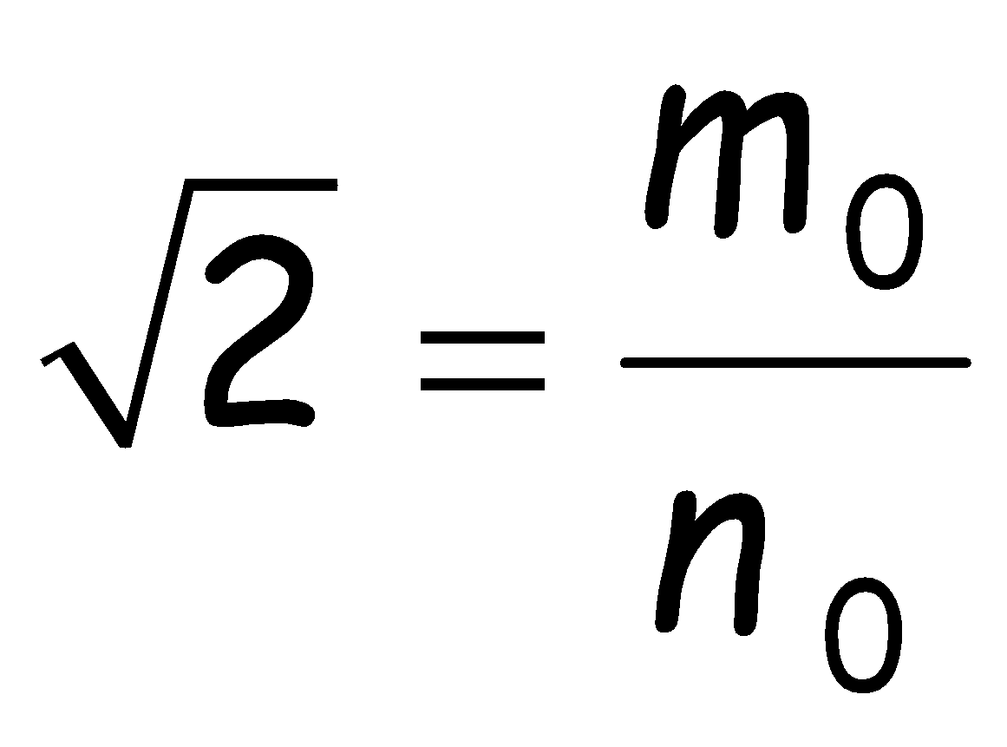
Well Ordering Principle
Thm: is irrational
Proof: suppose
…can always find such m, n without common factors…
why always?
By WOP,  minimum |m| s.t.
so
where |m₀| is minimum.

Slide 13
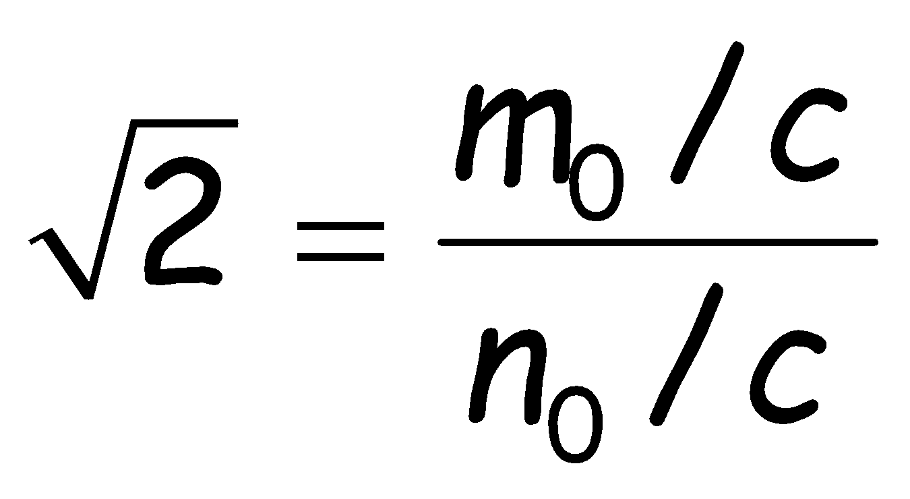
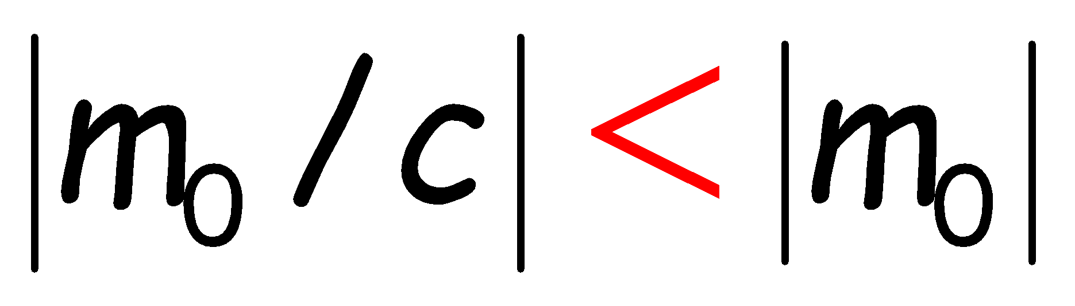
Well Ordering Principle
but if m₀, n₀ had common factor c > 1, then
and contradicting minimality of |m₀|
The well ordering principle is usually used in “proof by contradiction”.
Assume the statement is not true, so there is a counterexample.
Choose the “smallest” counterexample, and find a even smaller counterexample.
Conclude that a counterexample does not exist.

Slide 14
Well Ordering Principle in Proofs
To prove ``nN. P(n)’’ using WOP:
Define the set of counterexamples
C ::= {n  | ¬P(n)}
2. Assume C is not empty.
3. By WOP, have minimum element m₀  C.
4. Reach a contradiction (somehow) –
usually by finding a member of C that is < m₀ .
5. Conclude no counterexamples exist. QED

Slide 15
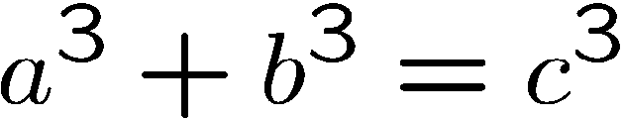
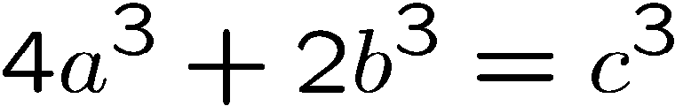
Non-Fermat Theorem
It is difficult to prove there is no positive integer solutions for
Fermat’s theorem
But it is easy to prove there is no positive integer solutions for
Non-Fermat’s theorem
Hint: Prove by contradiction using well ordering principle…

Slide 16
Non-Fermat Theorem
Suppose, by contradiction, there are integer solutions to this equation.
By the well ordering principle, there is a solution with |a| smallest.
In this solution, a,b,c do not have a common factor.
Otherwise, if a=a’k, b=b’k, c=c’k,
then a’,b’,c’ is another solution with |a’| < |a|,
contradicting the choice of a,b,c.
(*) There is a solution in which a,b,c do not have a common factor.

Slide 17
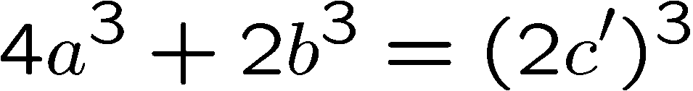
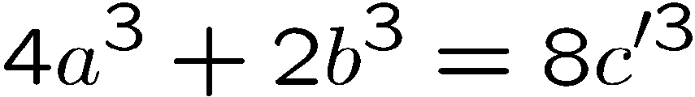
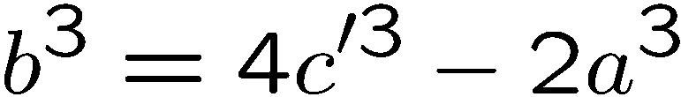
Non-Fermat Theorem
On the other hand, we prove that every solution must have a,b,c even.
This will contradict (*), and complete the proof.
First, since c³ is even, c must be even.
(because odd power is odd).
Let c = 2c’, then

Slide 18
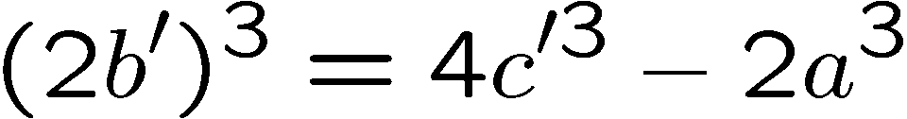
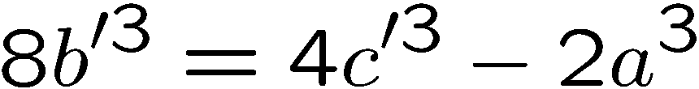
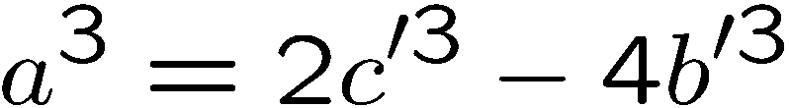
Non-Fermat Theorem
Since b³ is even, b must be even. (because odd power is odd).
Let b = 2b’, then
Since a³ is even, a must be even. (because odd power is odd).
There a,b,c are all even, contradicting (*)

